Slide 1
CST8333 Assignment 1
Space guy: Blockade – arcade style space shooter
Andrew Gaal
February 10, 2022

Slide 2
Introduction
Space Guy: Blockade is an arcade-style space shooter in the tradition of games like Galaga and Platypus.
Space Guy will deliver:
Fast-paced, challenging gameplay
A fully offline experience – No DRM or reliance on company servers for functionality
A local high score table to track personal progress and compete with friends
A fully featured version of the game was determined to be feasible, however versions cutting out optional requirements are available should schedule slippage occur.
Schedule slippage is the primary risk, with these likely causes:
Discovery of new requirements late in development
Unforeseen limitations of Python/Pygame blocking development of a requirement
External commitments taking away from development time

Slide 3
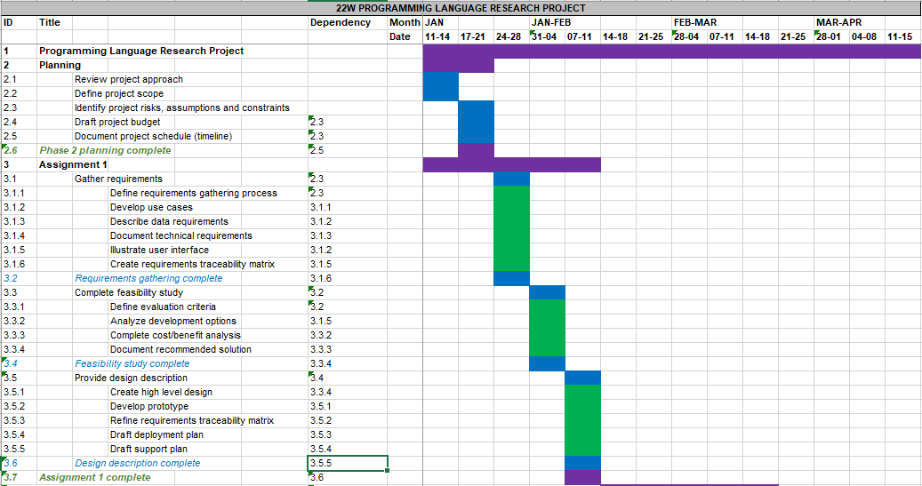
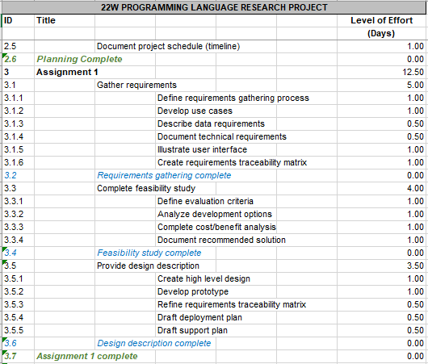
Details – Timeline & Budget
Timeline
The project is proceeding on schedule. There was some early schedule slippage due to external commitments demanding attention. These were addressed and extra time was devoted to the project to compensate.
Budget
The budget is based on level of effort rather than financial input. Thus far, budget estimates have been accurate.

Slide 4
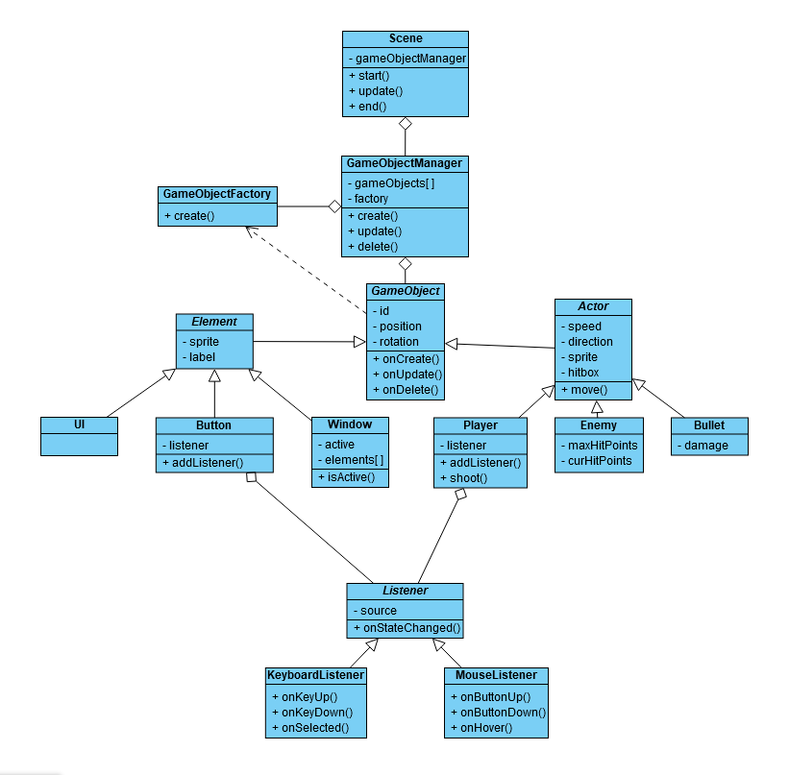
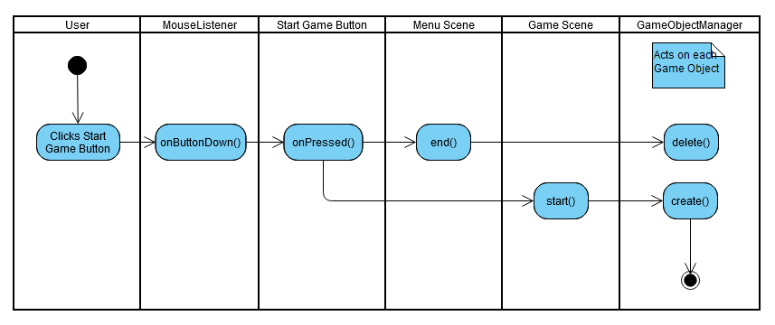
Details - Architecture
Class Diagram
This diagram represents the planned class architecture for the game. While it may change based on the capabilities and limitations of Python, it serves as the starting point for development.
Activity Diagram
This diagram depicts the general sequence of activities involved in transitioning from one game screen (scene) to another. Here we can get a sense of how the various classes will interact with one another.

Slide 5
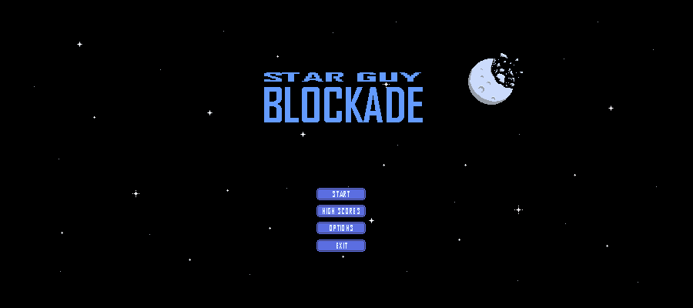
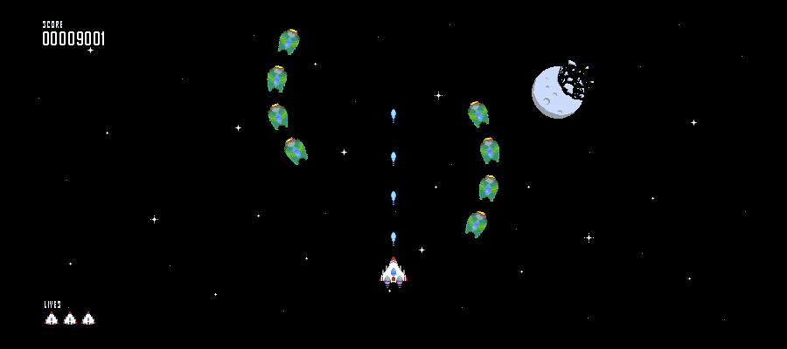
Details – UI Mockup
Menu Scene
This scene serves as the main point of navigation throughout the game. From here, the player can start the game, view the high score table, open the options menu, or quit. This scene is opened when the game launches.
Game Scene
This is the scene where the main gameplay loop takes place. The player controls the white ship while enemies fly from the top of the screen to the bottom in set patterns. The player scores points by destroying enemies. If the player is hit, they lose a life. When they run out of lives, the game ends and transitions to the High Score scene.

Slide 6
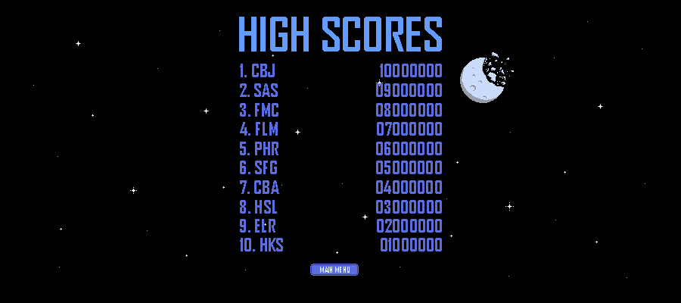
Conclusion
Phase 1, project initiation, is now complete.
With the system architecture now largely mapped out, development can begin. 60% of the source code is scheduled to be completed by the end of Phase 2, and 100% by the end of Phase 3.
Further changes to project requirements will be tracked and mapped onto the Requirements Traceability Matrix, which will serve as the basis of system testing in Phase 3.

